Slide 1
Unit - 1
UNIT - I: Introduction - Concepts and definitions: disaster, hazard, vulnerability, resilience, risks severity, frequency and details, capacity, impact, prevention, mitigation.

Slide 2
DISASTER
Desastre - French word - 'des' meaning bad and 'aster' meaning star.
An event, natural or human made sudden or progressive, which impacts with such severity that the affected community has to respond by taking exceptional measures
Or
A serious disruption in the functioning of the community or a society causing wide spread material, economical, society to cope using its own resources
Or
As per DISASTER MANAGEMENT ACT, 2005 “ A catastrophe, mishap, calamity or grave occurrence in any are, arising from natural or manmade causes, or by accident or negligence which results in substantial loss of life or human suffering or damage to, and destruction of, property or damage to, or degradation of, environment, and is of such a natural or magnitude as to be beyond the coping capacity of community of the affected area”
Or
The United Nations defines disaster as “the occurrence of sudden or major misfortune which disrupts the basic fabric and normal functioning of the society or community”

Slide 3
DISASTER BACKGROUND
Disasters are as old as human history but the dramatic increase and the damage caused by them in the recent past have become a cause of national & international concern.
Over the past decade, the number of natural & man-made disasters have climbed inexorably.
Reported disasters average from 1994 to 1998, was 428/ yr
1999 to 2003 , was707 /yr Increase of about 60% over the previous years.
Nearly 90% of disaster-related deaths and 98% of people affected by disasters were in developing nations
Disasters are not new to mankind, they have been the constant through inconvenient, companions of the human beings since time immemorial.
NATURAL DISASTERS
floods, draught, cyclones, volcanoes, earthquakes, tsunami, landslides, coastal erosion, soil erosion, forest fires
MAN MADE DISASTERS
industrial pollution, artificial flooding in urban areas, nuclear radiation, chemical spills, transportation accidents, terrorist strikes

Slide 4
HAZARD
HASARD - French
Hazards are defined as physical phenomena that pose a threat to the people structures or economic asserts and which may cause a disaster.”
Or
Hazard may be defined as “A dangerous condition or event that threat ot have the potential for causing injury to life or damage to property or the evniroment”

Slide 5
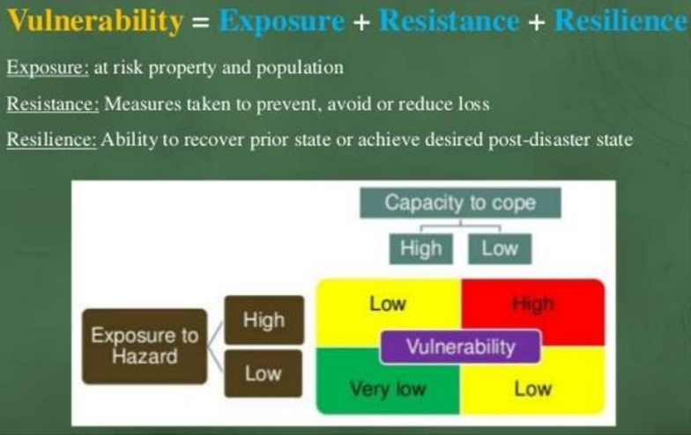
VULNERABILITY
The extent to which a community structure, services or geographic area is likely to be damaged or disrupted by the impact of particular hazard, on account of their nature, construction and proximity to hazardous terrains or a disaster prone area

Slide 6
RESILIENCE
Resilire – latin word – bounce back
Engineering Resilience : time taken by a system to bounce-back from shocks
Ecological Resilience – the extent of disturbance a system can take without undergoing structural change
Disaster Resilience is the ability of individuals, communities, organizations and states to adapt to and recover from hazards, shocks or stresses without compromising long-term prospects for development.

Slide 7
RISK
The probability of harmful consequences or expected losses resulting from interaction between natural or human induced hazards and vulnerable conditions
or
Measure of the expected losses due to a hazard event occurring in a given area over a specific time period. Risk is a function of the probability of particular hazardous event & losses each would cause

Slide 8
CAPACITY
The resources of individuals, households and communities to cope with a threat or resist the impact of a hazard
Or
Resources, means and strengths which exist in households and communities and which enable them to cope with, withstand, prepare for, prevent, mitigate or quickly recover from a disaster

Slide 9
PREVENTION
Activities to avoid the adverse impact of hazards and means to check from turning into disasters
MITIGATION
Mitigation means measures aimed at reducing the risk, impact or effects of a disaster or threatening disaster situation.
Measures taken in advance of a disaster aimed at reducing its impact on society and the environment.

Slide 10
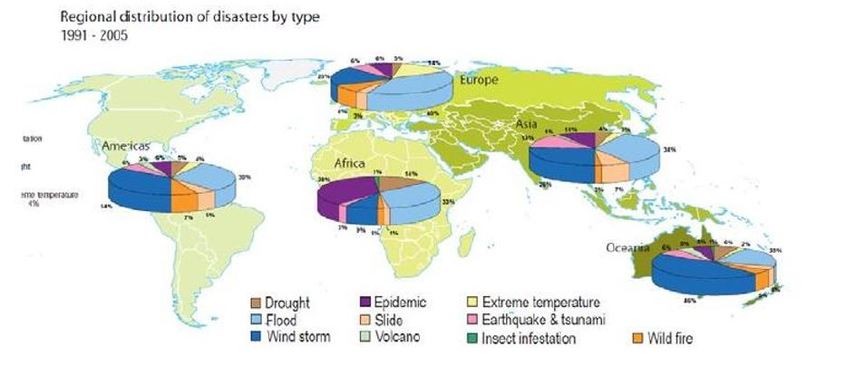

Slide 11
International disasters
Sl.no
Death toll
Event
Location
Date
(
Highest estimate)
1.
4,000,000
1931 China floods
July 1931
2.
2,000,000
1887 Yellow River flood
September 1887
China
3.
830,000
1556 Shaanxi earthquake
January 23, 1556
4.
655,000
1976 Tangshan earthquake
July 28, 1976
5.
500,000+
1970 Bhola cyclone
East Pakistan
(now Bangladesh)
November 13, 1970
6.
316,000
2010 Haiti earthquake
Haiti
January 12, 2010
7.
300,000+
526 Antioch earthquake
Byzantine Empire
(now Turkey)
May 526
8.
300,000
1839 India Cyclone
Andhra Pradesh, India
November 25, 1839
9.
273,400
1920 Haiyuan earthquake
December 16, 1920
China
10.
229,000
Typhoon Nina
August 7, 1975

Slide 12
National disasters
Sl.no
Death toll
Event
Location
Date
(
Highest estimate)
1.
5,700 plus
Uttarakhand Flash Floods
Uttarakhand
2013
2.
1,287
Bihar flood disaster
Bihar
2007
3.
2,30,000
The Indian Ocean Tsunami
Southern India & Andaman
2004
4.
20,000
Gujarat Earthquake
Gujarat
2001
5.
15,000
Super Cyclone, Odisha
Odisha
1999
6.
1 crore
Great Bengal Famine
West Bengal
1770
7.
3,787
Bhopal gas tragedy
Madhya Pradesh
1984
8.
300,000
India Cyclone
Andhra Pradesh, India
November 25, 1839

Slide 13
Vulnerability
Physical Vulnerability:
It includes notions of who and what may be damaged or destroyed by natural hazard such as earth-quakes or floods.
It is location based, on the physical condition of people and elements at risk, such as buildings, infrastructure etc; and their proximity and nature of the hazard.
It also relates to the technical capability of building and structures to resist the forces acting upon them during a hazard event.
Socio-economic Vulnerability:
The degree to which population is affected by a hazard will not merely lie in the physical components of vulnerability but also on the socio-economic conditions.
The socio-economic condition of the people also determines the intensity of the impact.
For example, people who are poor and living in the sea coast don’t have the money to construct strong concrete houses.
They are generally at risk and loose their shelters whenever there is strong wind or cyclone. Because of their poverty they too are not able to rebuild their houses.

Slide 14
Vulnerability in India
India is vulnerable, in varying degrees, to a large number of disasters.
More than 58.6 percent of the land mass is prone to earthquakes of moderate to very high intensity;
Over 40 million hectares(12%) of its land is prone to floods and river erosion;
Close to 5,700kms, out of the 7,516kms long coastline is prone to cyclones and tsunamis;
68% of its cultivable area is vulnerable to droughts; and, its hilly areas are at risk from landslides and avalanches.
More over, India is also vulnerable to Chemical, Biological, Radiological and Nuclear (CBRN) emergencies and other man-made disasters.

Slide 15
Of the 7,516 km long coastline, close to 5,700 km is prone to cyclones and tsunamis.

Slide 16
58.6 per cent of the landmass is prone to earthquakes of moderate to very high intensity.

Slide 17
Over 40 million hectares (12 per cent of land) is prone to floods and river erosion.

Slide 18
vulnerability and risk

Slide 20
Characteristics of vulnerability.
Multi-dimensional : physical, social, economic, environmental, institutional, and human factors define vulnerability
Dynamic : vulnerability changes over time;
Scale-dependent : vulnerability can be expressed at different scales from human to household to community to country resolution
Site-specific : changes with location

Slide 21
Frequency and Magnitude of hazards
Frequency :The frequency of a natural hazard event is the number of times it occurs within a specified time interval.
Magnitude: The magnitude of a natural hazard event is related to the energy released by the event.
It is distinguished from intensity which is related to the effects at a specific location or area.
The magnitude of a natural hazard event varies in its frequency of occurrence over time in an inverse power relationship.
The relationship is often depicted as log-normal where the magnitude increases linearly (e.g.,1,2,3,…) where as the frequency decreases as an inverse power function(e.g.,1/3,1/9,1/81) with increasing magnitude.
In other words, the larger and the more energetic the event, the rarer it is in time.

Slide 22
The magnitude and frequency of natural hazards are generally inversely related-the larger the magnitude, the less frequent the event.
The impact is not directly related to the magnitude of the natural event but is also closely linked to human factors.
Majority of hazards have return periods on a human time-scale. Examples are five-year flood, fifty-year flood and a hundred year flood. This reflects a statistical measure of how often a hazard event of a given magnitude and intensity will occur. The frequency is measured in terms of a hazard’s recurrence interval.
For example, a recurrence interval of 100 years for a flood suggests that in any year, a flood of that magnitude has a 1% chance of occurring.
Such extreme events have very low frequencies but very high magnitudes in terms of destructive capacity. This means that an event considered being a hundred year flood would cause severe damage compared to a five-year flood.

